Slide 1
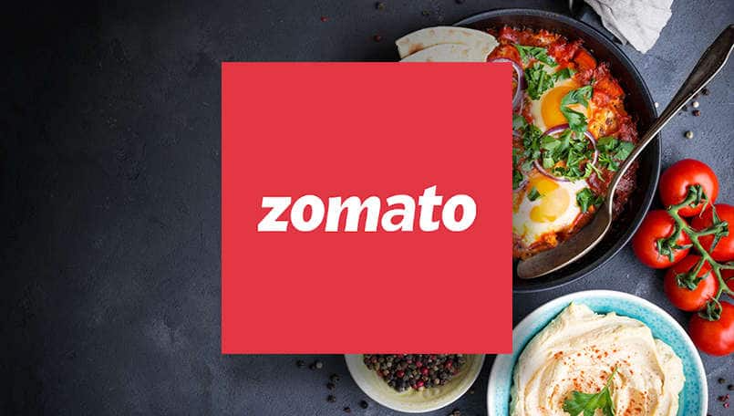

DATA ANALYSIS ZOMATO ANALYSIS
DONE BY GROUP 3

Slide 2

MEMBERS
ASWATHY K L
AKASH SABU
PRAKHYATI SWETHA
MINNU VARGHESE
DEEPAK S
AKHILESH RANVINDRA

Slide 3
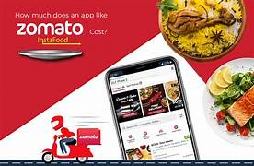
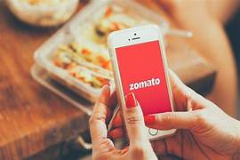
ABOUT PROJECT
Analyzing Zomato, the popular food delivery and restaurant discovery platform, involves assessing various aspects of the company to gain insights into its operations, market presence, financial performance, and user data. Zomato Analysis can be conducted for different purposes, including market research, investment decision-making, and understanding trends in the food and restaurant industry.

Slide 4
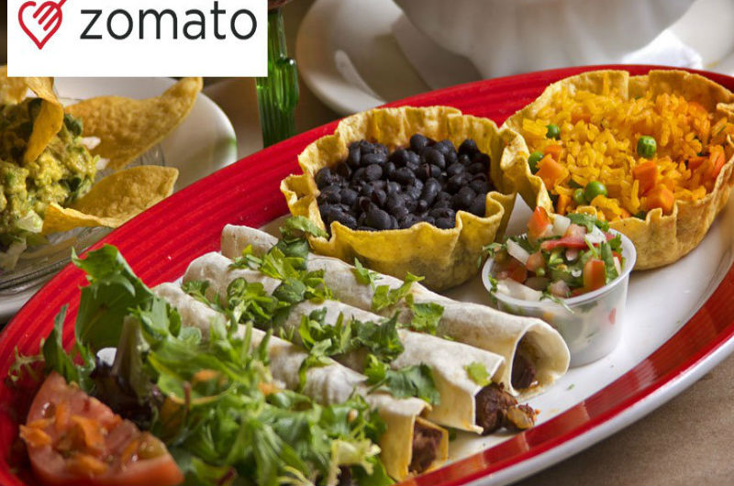
EFFECTS
Analyzing data from Zomato, a popular restaurant and food delivery service, can have various effects and benefits for different stakeholders, including consumers, restaurants, Zomato itself, and the broader food industry.
CONSUMERS
Improved Dining Experience
Personalized Recommendations
Access to Restaurant Information
Access to Reviews and Ratings
Discounts and Offers
RESTAURANTS
Feedback and Improvement
Customer Insights
Performance Metrics
Pricing and Marketing Strategies

Slide 5

EFFECTS
FOOD INDUSTRY
Market Insights
Health and Safety Compliance
Food Delivery and Restaurant Trends
ZOMATO
Improved User Experience
Marketing and Partnerships
Market Expansion and Decision-Making
Operational Efficiency
Revenue Growth

Slide 6

CAUSES
Zomato analysis is conducted for various reasons, and there are several underlying causes or motivations for performing such an analysis. Here are some common causes for conducting a Zomato analysis
Investment Decision-Making
Business Strategy and Planning
Market Research
Financial Performance Evaluation
User Experience Enhancement
Stock Performance Evaluation
Community Feedback and Support
Environmental and Social Impact

Slide 7

BUSINESS OBJECTIVE
The business objectives of Zomato analysis are aligned with the company's goals and strategies to enhance its food delivery and restaurant discovery platform. Zomato leverages data analysis to achieve various key business objectives, including.
Market Research and Positioning
Financial Performance Evaluation
User Experience Enhancement
Competition Assessment
Government and Regulatory Compliance:
Stock Performance Evaluation
Community Feedback and Support
Environmental and Social Impact
Enhancing User Experience
Personalized Recommendations

Slide 8
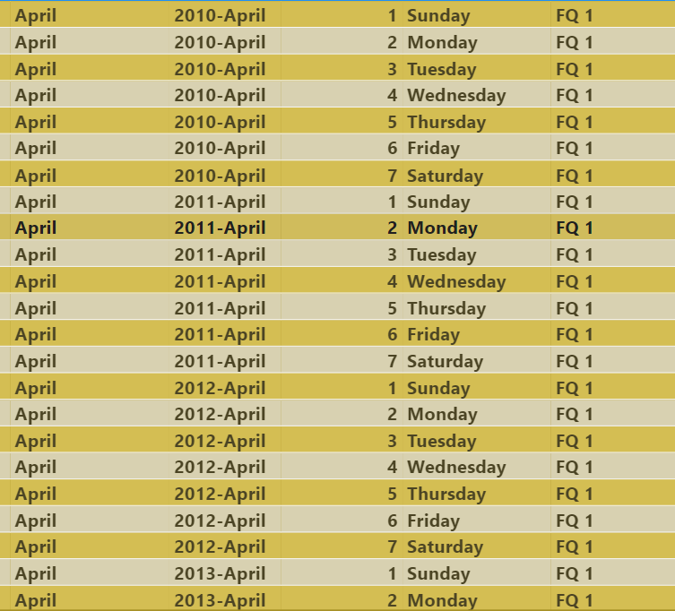
Calendar Table using the Column Datekey
Year (data key)
MonthNo (data key)
MonthFullName (data key)= TEXT(DateKey, "MMMM")
Quarter (data key)= CHOOSE(MATCH(Month(DateKey),{1,4,7,10}), "Q1", "Q2", "Q3", "Q4")
YearMonth ()= TEXT(DateKey, "yyyy-mmm")
WeekdayNo ()= WEEKDAY(DateKey,2)
WeekdayName()= TEXT(DateKey, "dddd")
FinancialMonth ()= =IF(MONTH(DateKey) < 4, "FM" & MONTH(DateKey) + 9, "FM" & MONTH(DateKey) - 3)
FinancialQuarter ()= =CHOOSE(MATCH(MONTH(DateKey),{1,4,7,10}), "FQ4", "FQ1", "FQ2", "FQ3")

Slide 9
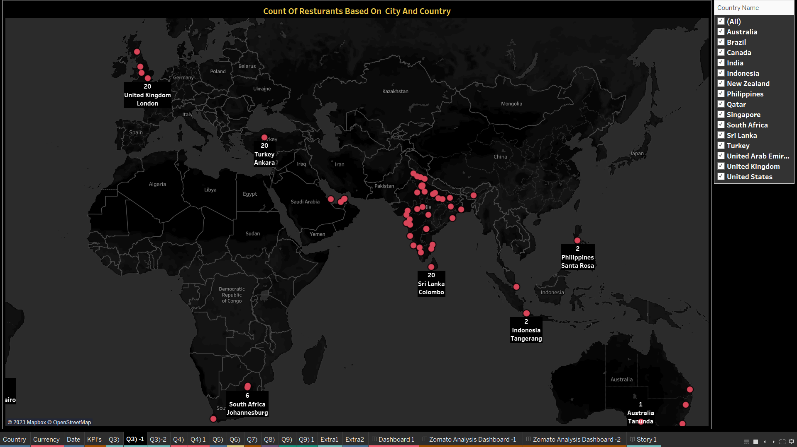
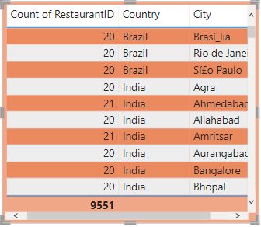
Numbers of Resturants based on City and Country
In the graph there are 15 country ,141 city we have to find number of resturants based on country and city ,for that we take restaurant ID ,city and country .
To display the number of restaurants we need a measure for that we use COUNTD aggregation
There are 9551 restaurants based on city and country

Slide 10
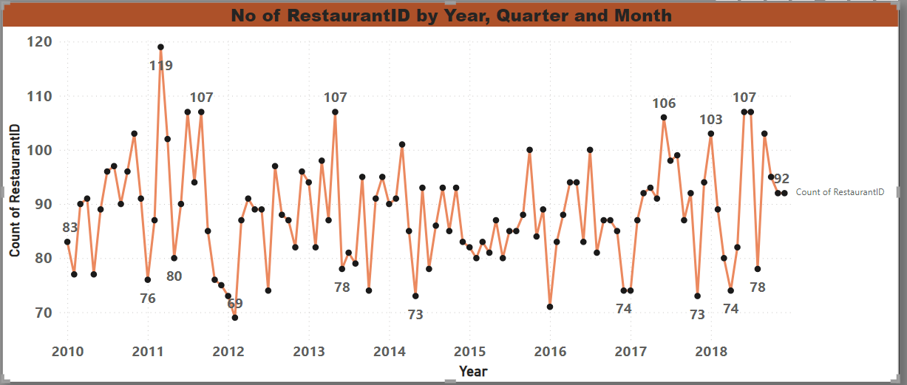
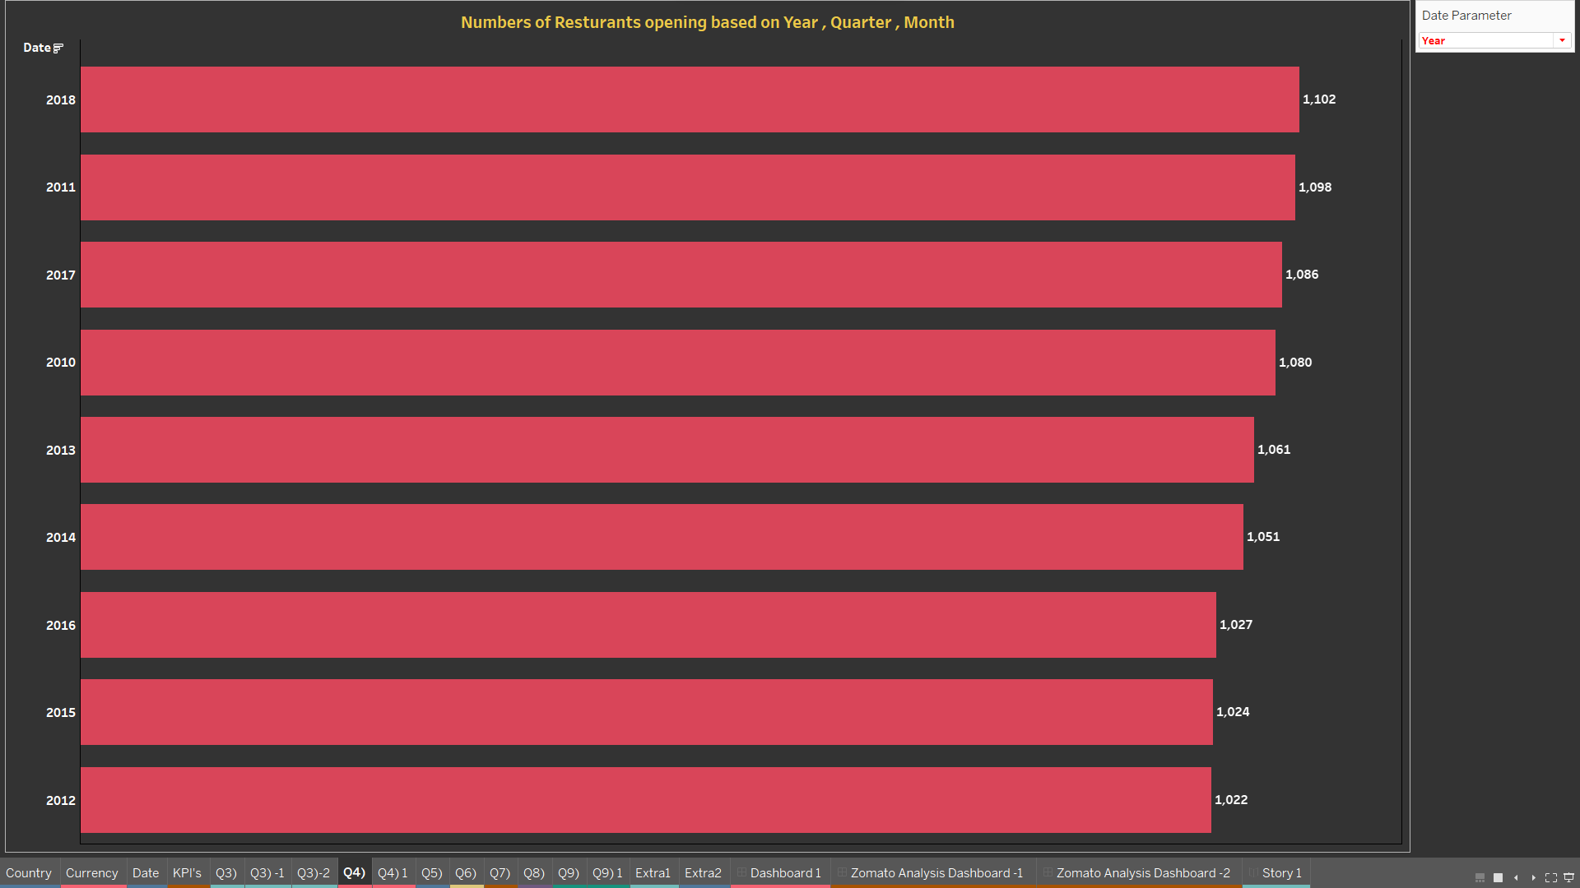
Numbers of Resturants opening based on Year , Quarter , Month
Here we have to find number of resturants open based on year,month,quarter,for that we have to take restaurant id and use COUNTD aggregation in res id ,then pick year,month,quarter from the calender table .
119 resturants opens in the year 2011 qtr 1 march is the highest
107 resturants opens in the year 2011 qtr 3 July
Lowest number of resturants open in the year 2014 qtr 4 may number of restaurant open is 73

Slide 11
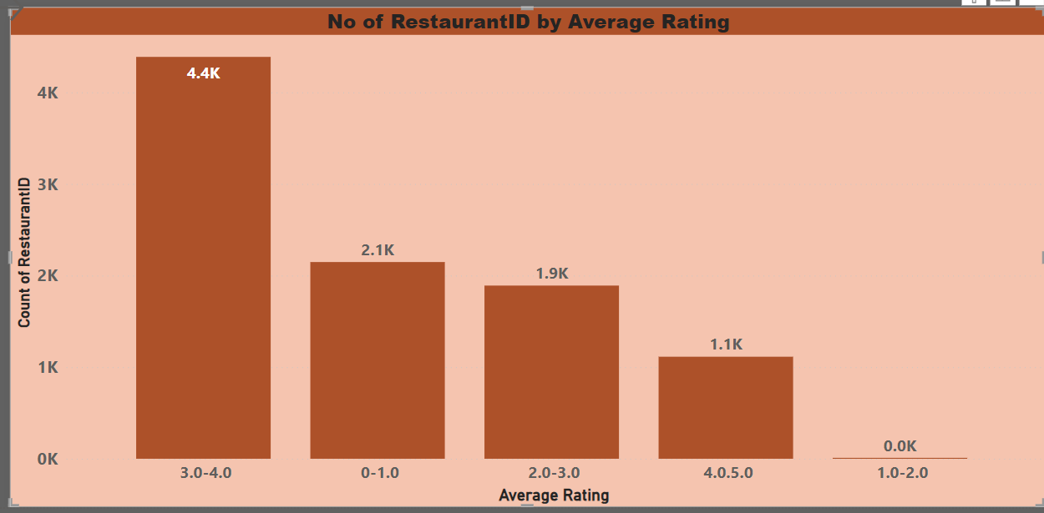
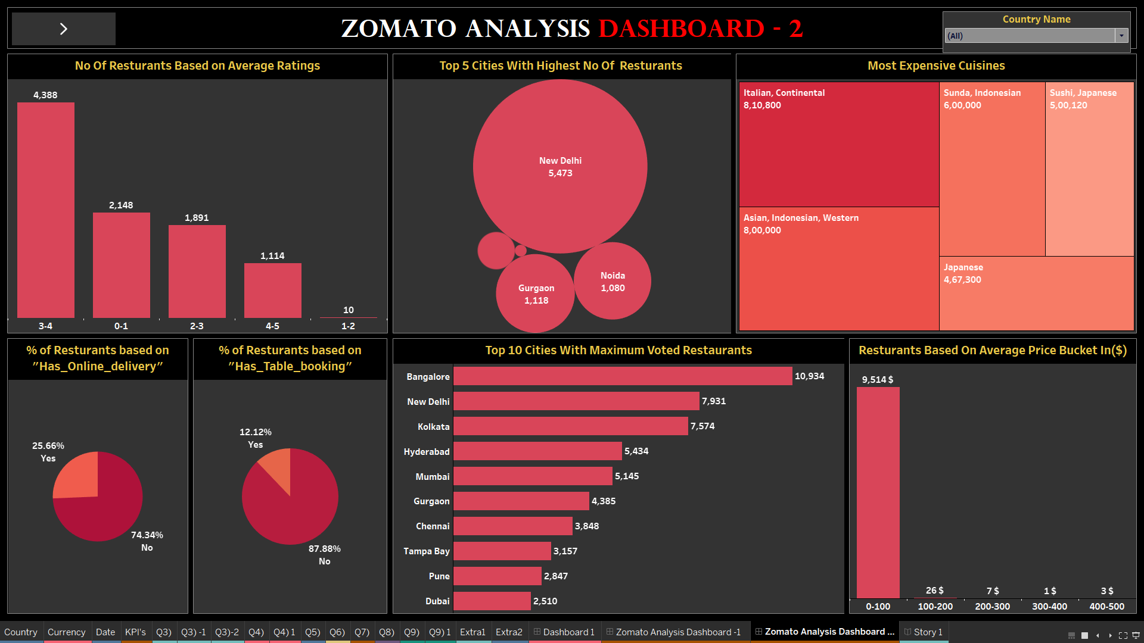
Count of Resturants based on Average Ratings.
Here we have to find count of resturants based on average rating for that we take restaurant id and use COUNTD aggregation in res id then take the ratings and change the measure as average .
Number of resturants between the rating 3-4 is 4388
Number of resturants between the rating 0-1.0 is 2148
Number of resturants between the rating 2-3 is 1891
Number of resturants between the rating 4-5 is 1114

Slide 12
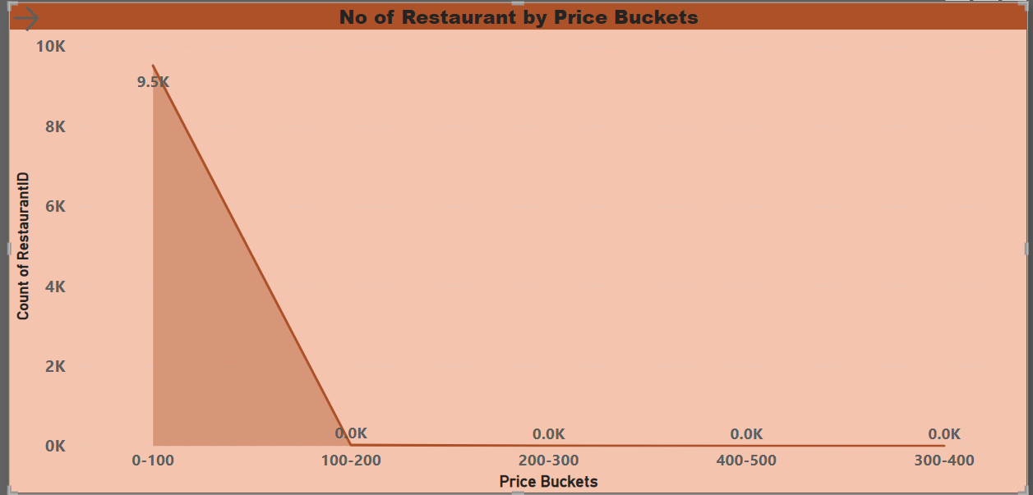
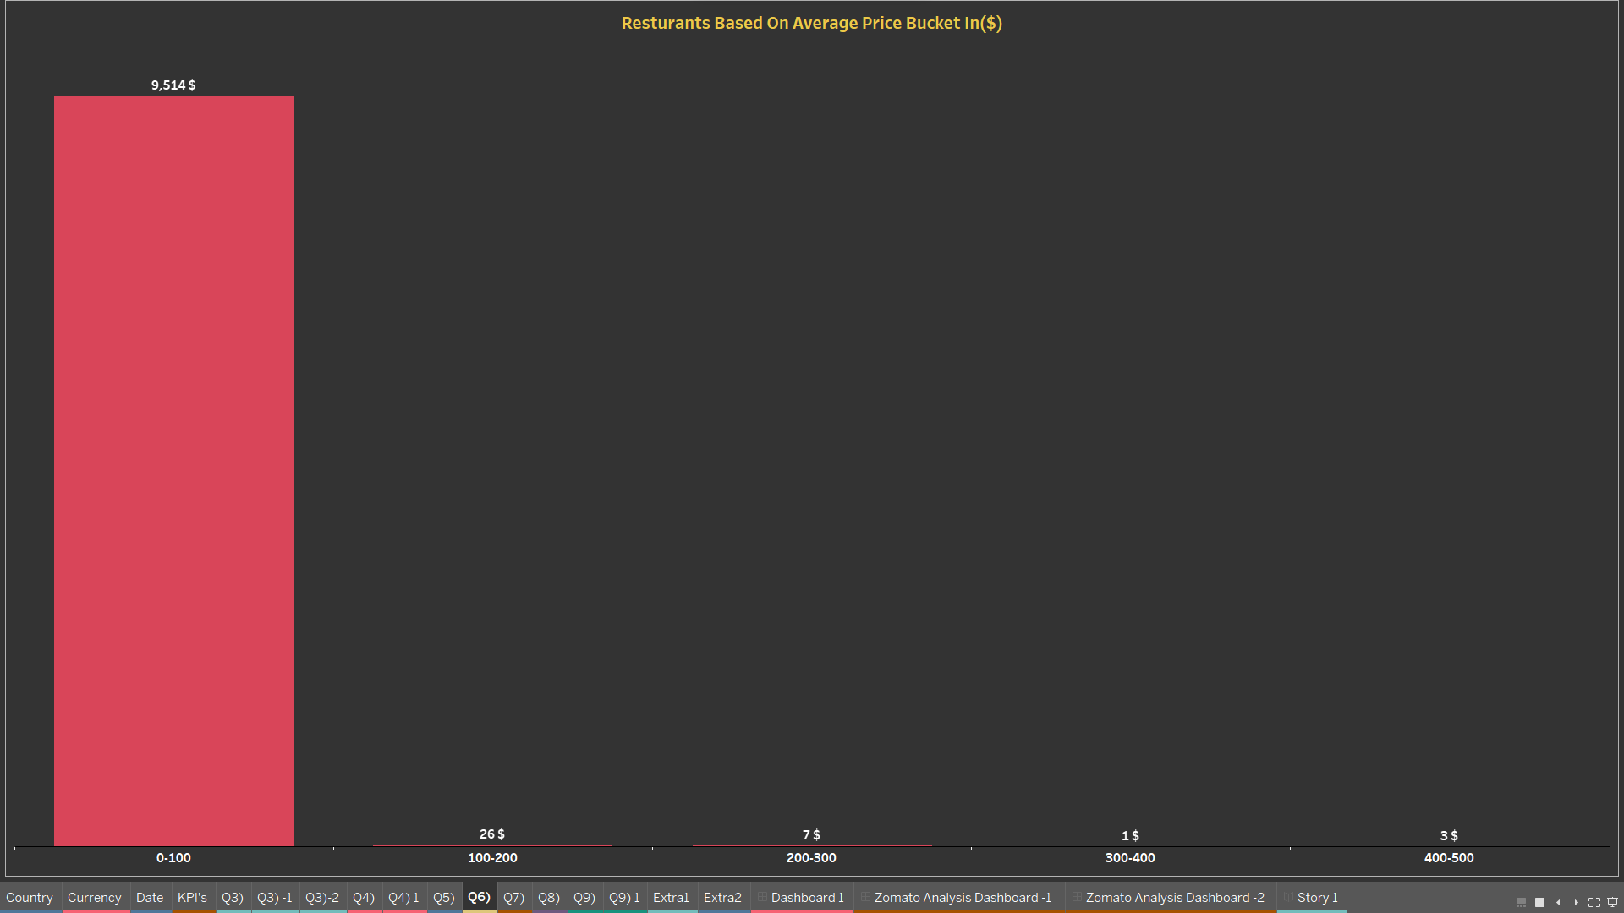
Create buckets based on Average Price of reasonable size and find out how many resturants falls in each buckets
1st create a price bucket use the given formula to find the price bucket
IF [Average Price] < 20 THEN 'Low'
ELSEIF [Average Price] >= 20 AND [Average Price] <= 50 THEN 'Medium'
ELSE 'High'
END
Price bucket upto 0-100 number of resturants opening is 9514
Price bucket upto 100-200 number of resturants opening is 26
Price bucket upto 200-300 number of resturants opening is7
Price bucket upto 400-500 number of resturants opening is 3
Price bucket upto 300-400 number of resturants opening is 1

Slide 13
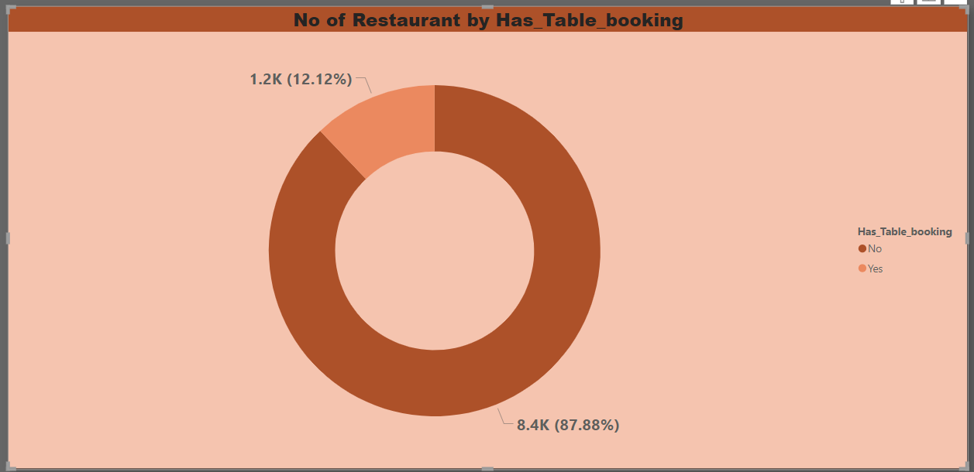
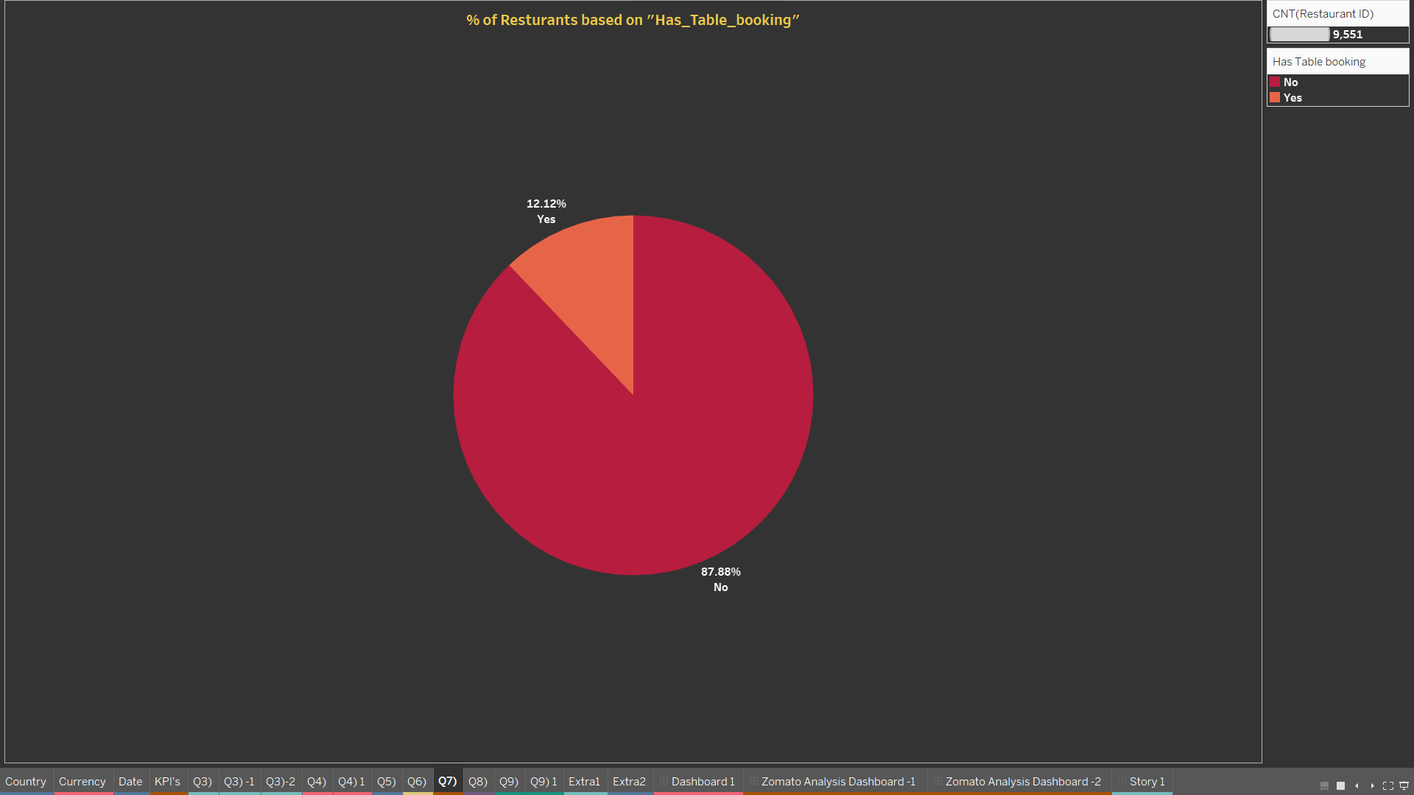
Percentage of Resturants based on "Has_Table_booking"
Count of resturants that has table booking is 1158 in percentage 12.12%
Count of resturants that has no table booking is 8393 in percentage 87.88%

Slide 14
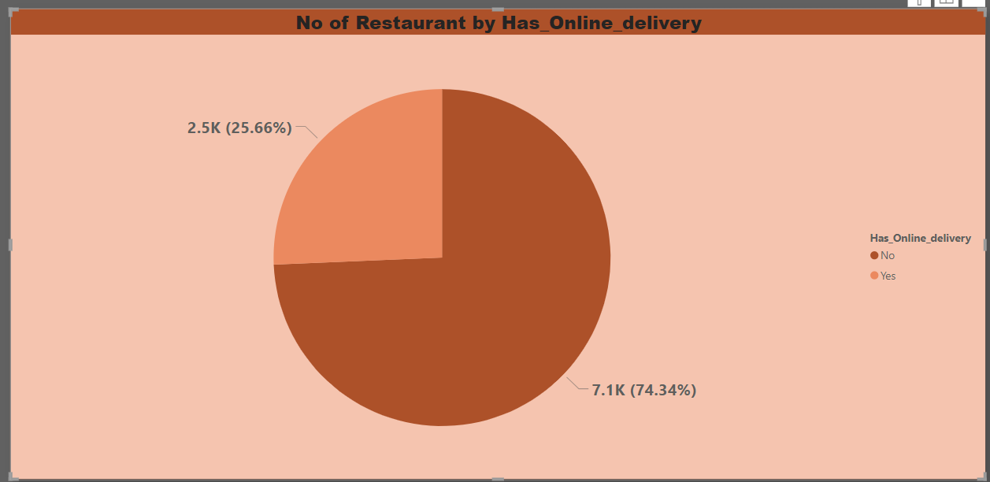
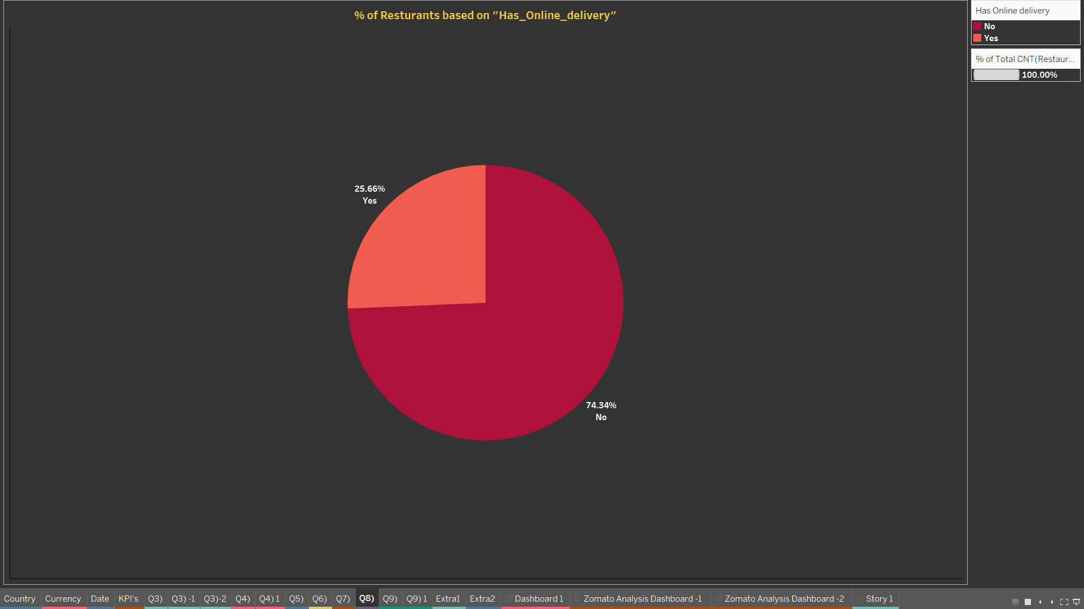
Percentage of Resturants based on "Has_Online_delivery"
Count of resturants that has online delivery is 2451 in percentage 25.16%
Count of resturants that has no online delivery is 7144 in percentage 74.34%

Slide 15
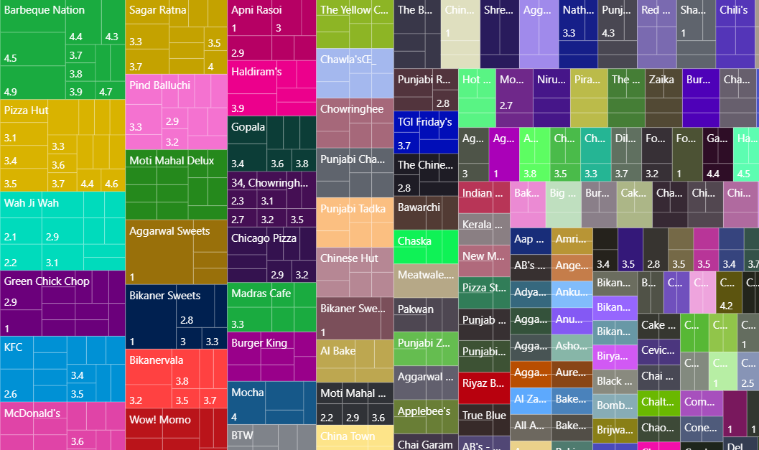
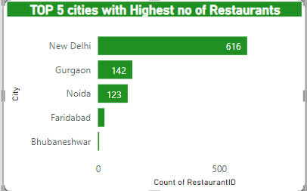
No of cuisines and average of rating by restaurant name
There are 1826 cuisines and the average rating is 2.8
Top 5 cities with highest no of Restaurants
New delhi is the 1st top most cities with the count of res 616
Guragon is the 2nd most city with count of res 142
Noida is the 3rd city with count of res 123
Faridabad is the 4th city with count of res 27

Slide 16
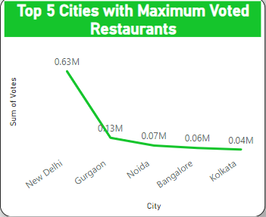
Top 5 cities with maximum voted restaurants
New delhi is the 1st top most city with max vote 62834
Gurgaon is the 2nd most city with max vote 132160
Nodia is the 3rd most city with max vote 73488
Bangalore is the 4th city with max vote 56115
kolkata is the 5th city with max vote 44593

Slide 17
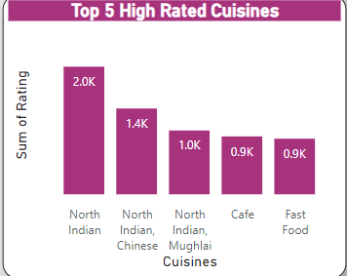
Top 5 high rated cuisines
North Indian is the 1st top most rated cuisines
North Indian and Chinese is the 2nd most rated cuisines
North indaian and Mughlai is the 3rd most rated cuisines
Café is the 4th rated cuisines
Fast food is the 5th rated cuisines

Slide 18
conclusion
In this analysis project, we have examined various aspects of Zomato, a prominent food delivery and restaurant discovery platform. Our findings and insights can be summarized as follows
Market Presence: Zomato has established a strong presence in the food delivery and restaurant discovery sector. Its platform is widely used by customers to access a variety of dining options.
Competition: The industry Zomato operates in is highly competitive, with other major players vying for market share. Zomato faces competition from the likes of Swiggy, UberEats, and local competitors in different regions.
Revenue Growth: Our analysis indicates that Zomato has experienced consistent revenue growth. This growth can be attributed to an increasing user base and a rise in the number of food orders placed through its platform.
Global Expansion: Zomato's international expansion efforts reflect its ambition to become a global leader in the food delivery and restaurant discovery industry. The success of these expansions is a key factor to monitor.
Challenges: It is important to acknowledge the challenges Zomato faces, particularly in achieving profitability in the food delivery segment. The industry's cost structure and intense competition have put pressure on profit margins.

Slide 19
THANK YOU

